Slide 1
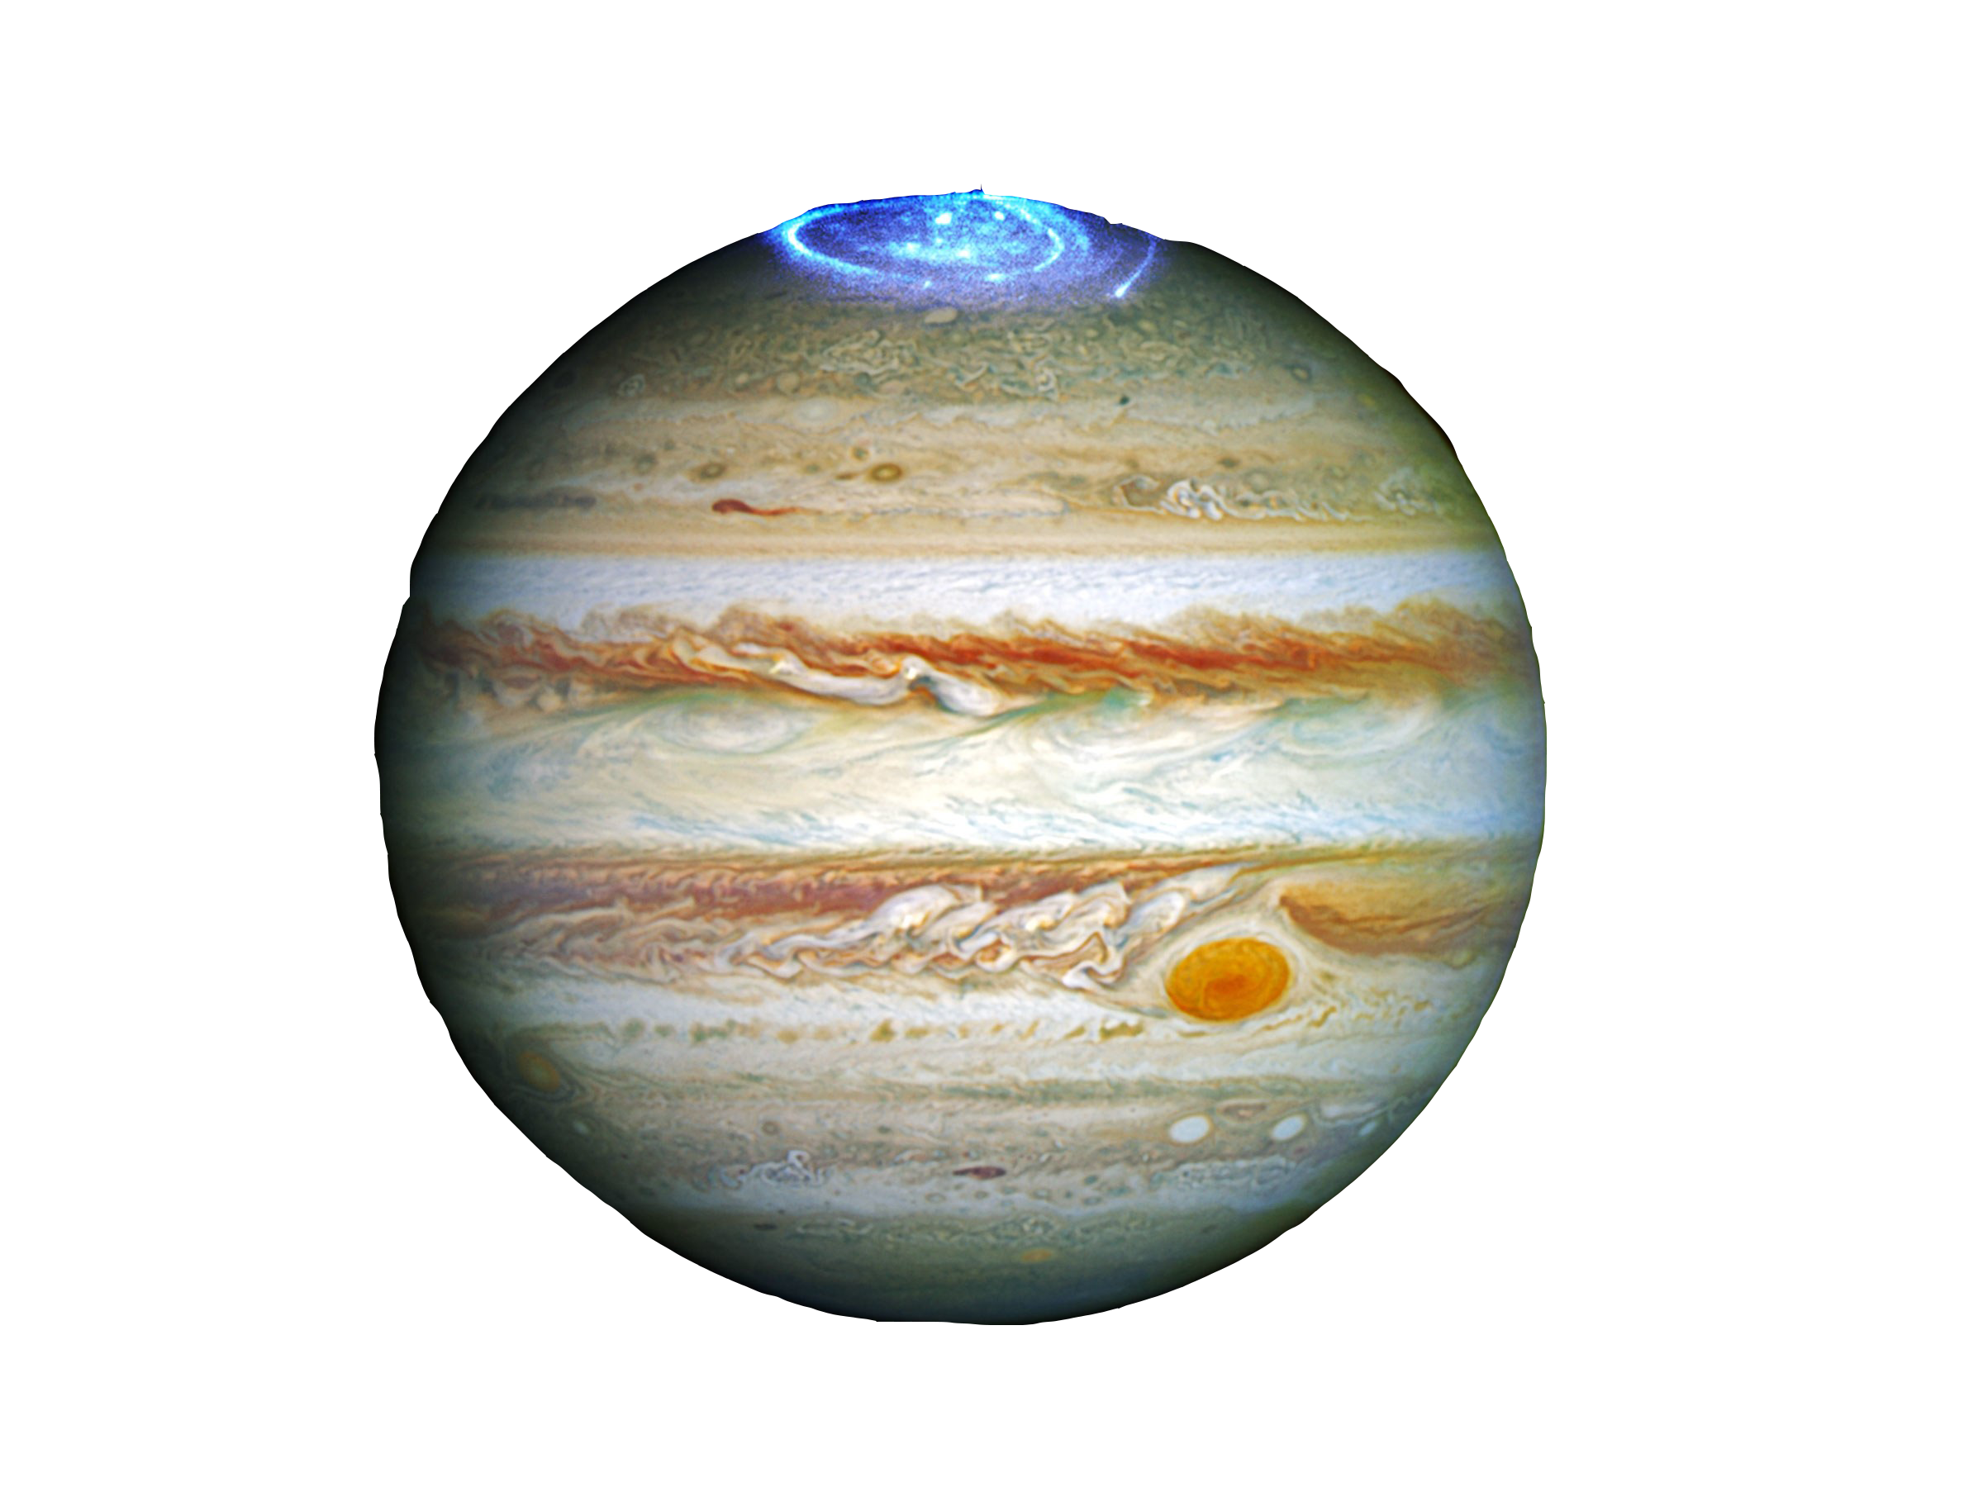
Gaia Sky
Real-time, 3D, astronomy visualisation software
Notes:
Kostis

Slide 2
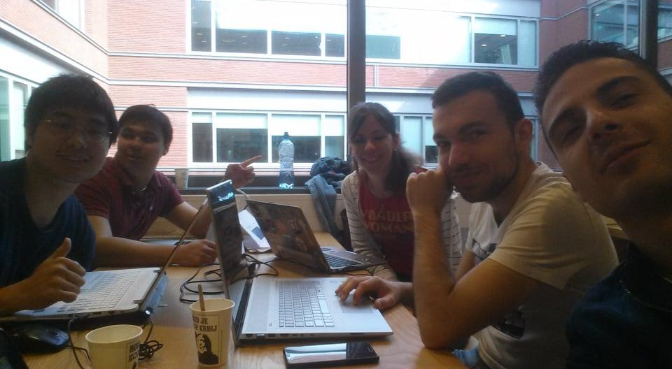

The team
Notes:
everyone

Slide 3
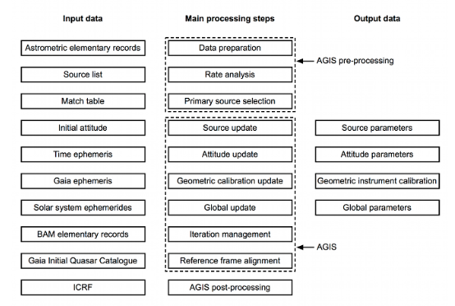
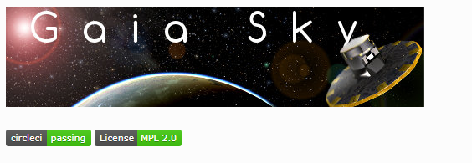
Gaia Visualization and pulsars
Introduction.
gaiasky open source software
processing data step DR1
Notes:
Moon Doc: https://zah.uni-heidelberg.de/institutes/ari/gaia/outreach/gaiasky/
The second Gaia data release is based on 22 months of mission data with an average of 0.9 billion individual CCD observations per day( by using Charged Coupled device : pros is it easy to record about 60 % of photon and it can record many star’s light automatic. Cons is that we need to processing huge data).
The picture of data processing step is established on Data release1.
The second gaia data release in April 2018 includes an improved astrometric solution based solely on gaia data.
By using Gaia data release2 public data. Gaia sky open source project has started.
Gaia sky is a real-time, 3d, astronomy visualization software that runs on windows, linux and mac os. With It you can explore gaia the solar system and the galaxy in real time.
It has have about three thousands commits made by 13 contributors. Representing 20 thousands lines of code. Mostly written in java.

Slide 4






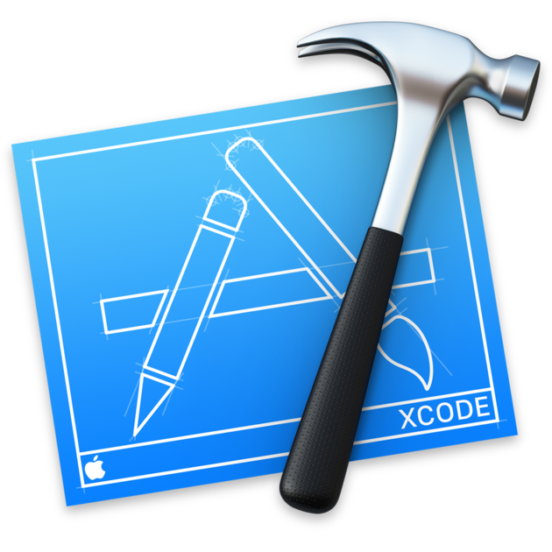
Tools used
Trello
Github
Discord
PyCharm
XCode
Eclipse
Intellij IDEA

Slide 5

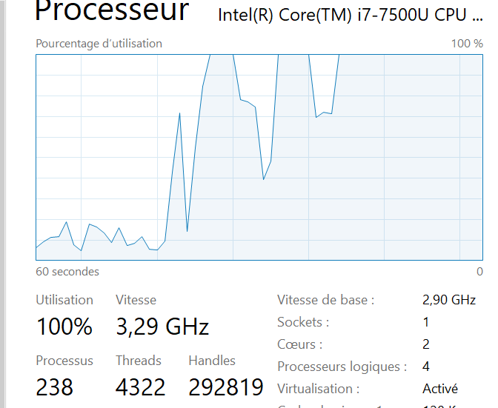
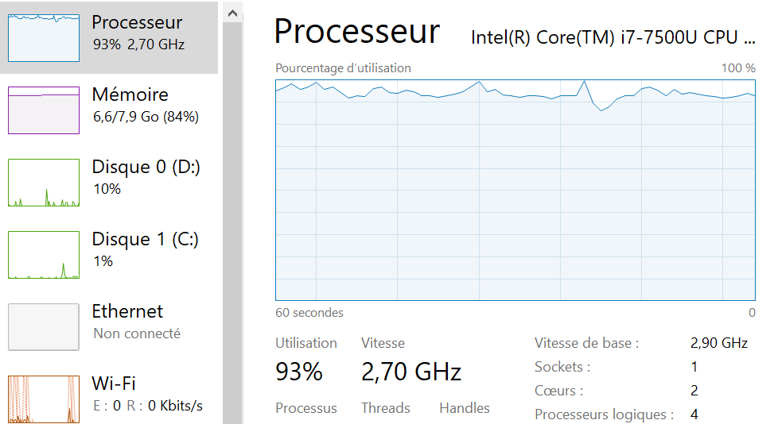
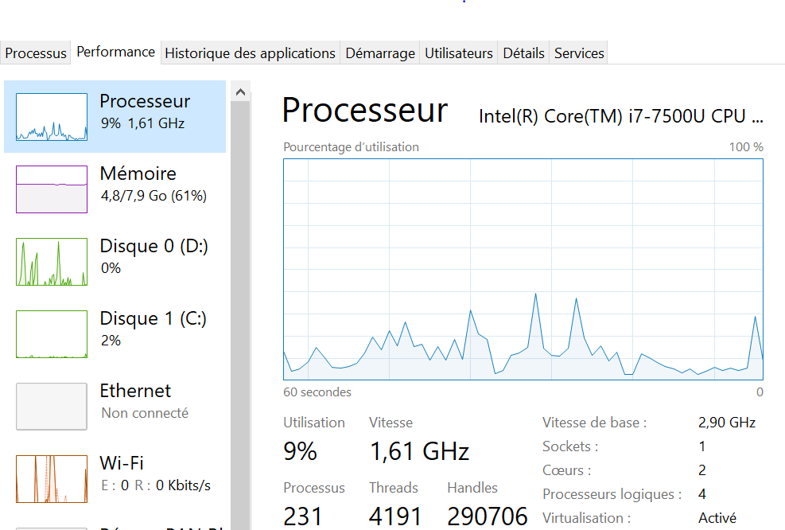
Issues we encountered
Installation not easy on Linux: several problems (version of Java, mysterious problem...)
The software needs a lot of computing power → many crashes (Win, MacOS, Linux)
Running script (api connection, Java JVM, …)
Notes:
Céline

Slide 6
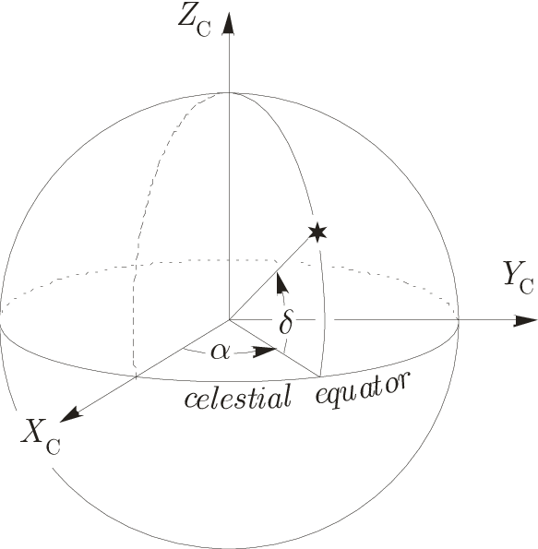
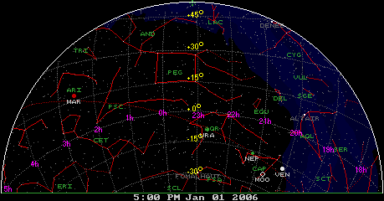
Coordinate Systems explained
Notes:
Kostis

Slide 7
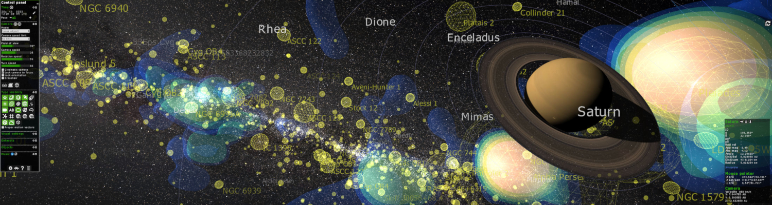
Showing you Gaia Sky!
Notes:
Nicolas + Kevin
Look around the software
=> go to an object
=> landing
=> option for seeing objects…

Slide 8



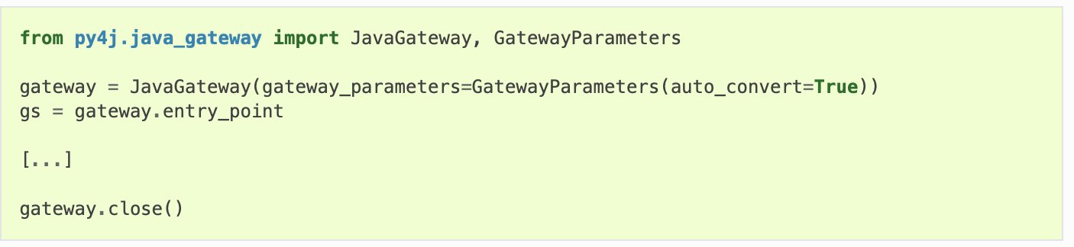
Scripting + a small demo
=
+
Notes:
Nicolas + Kevin

Slide 9

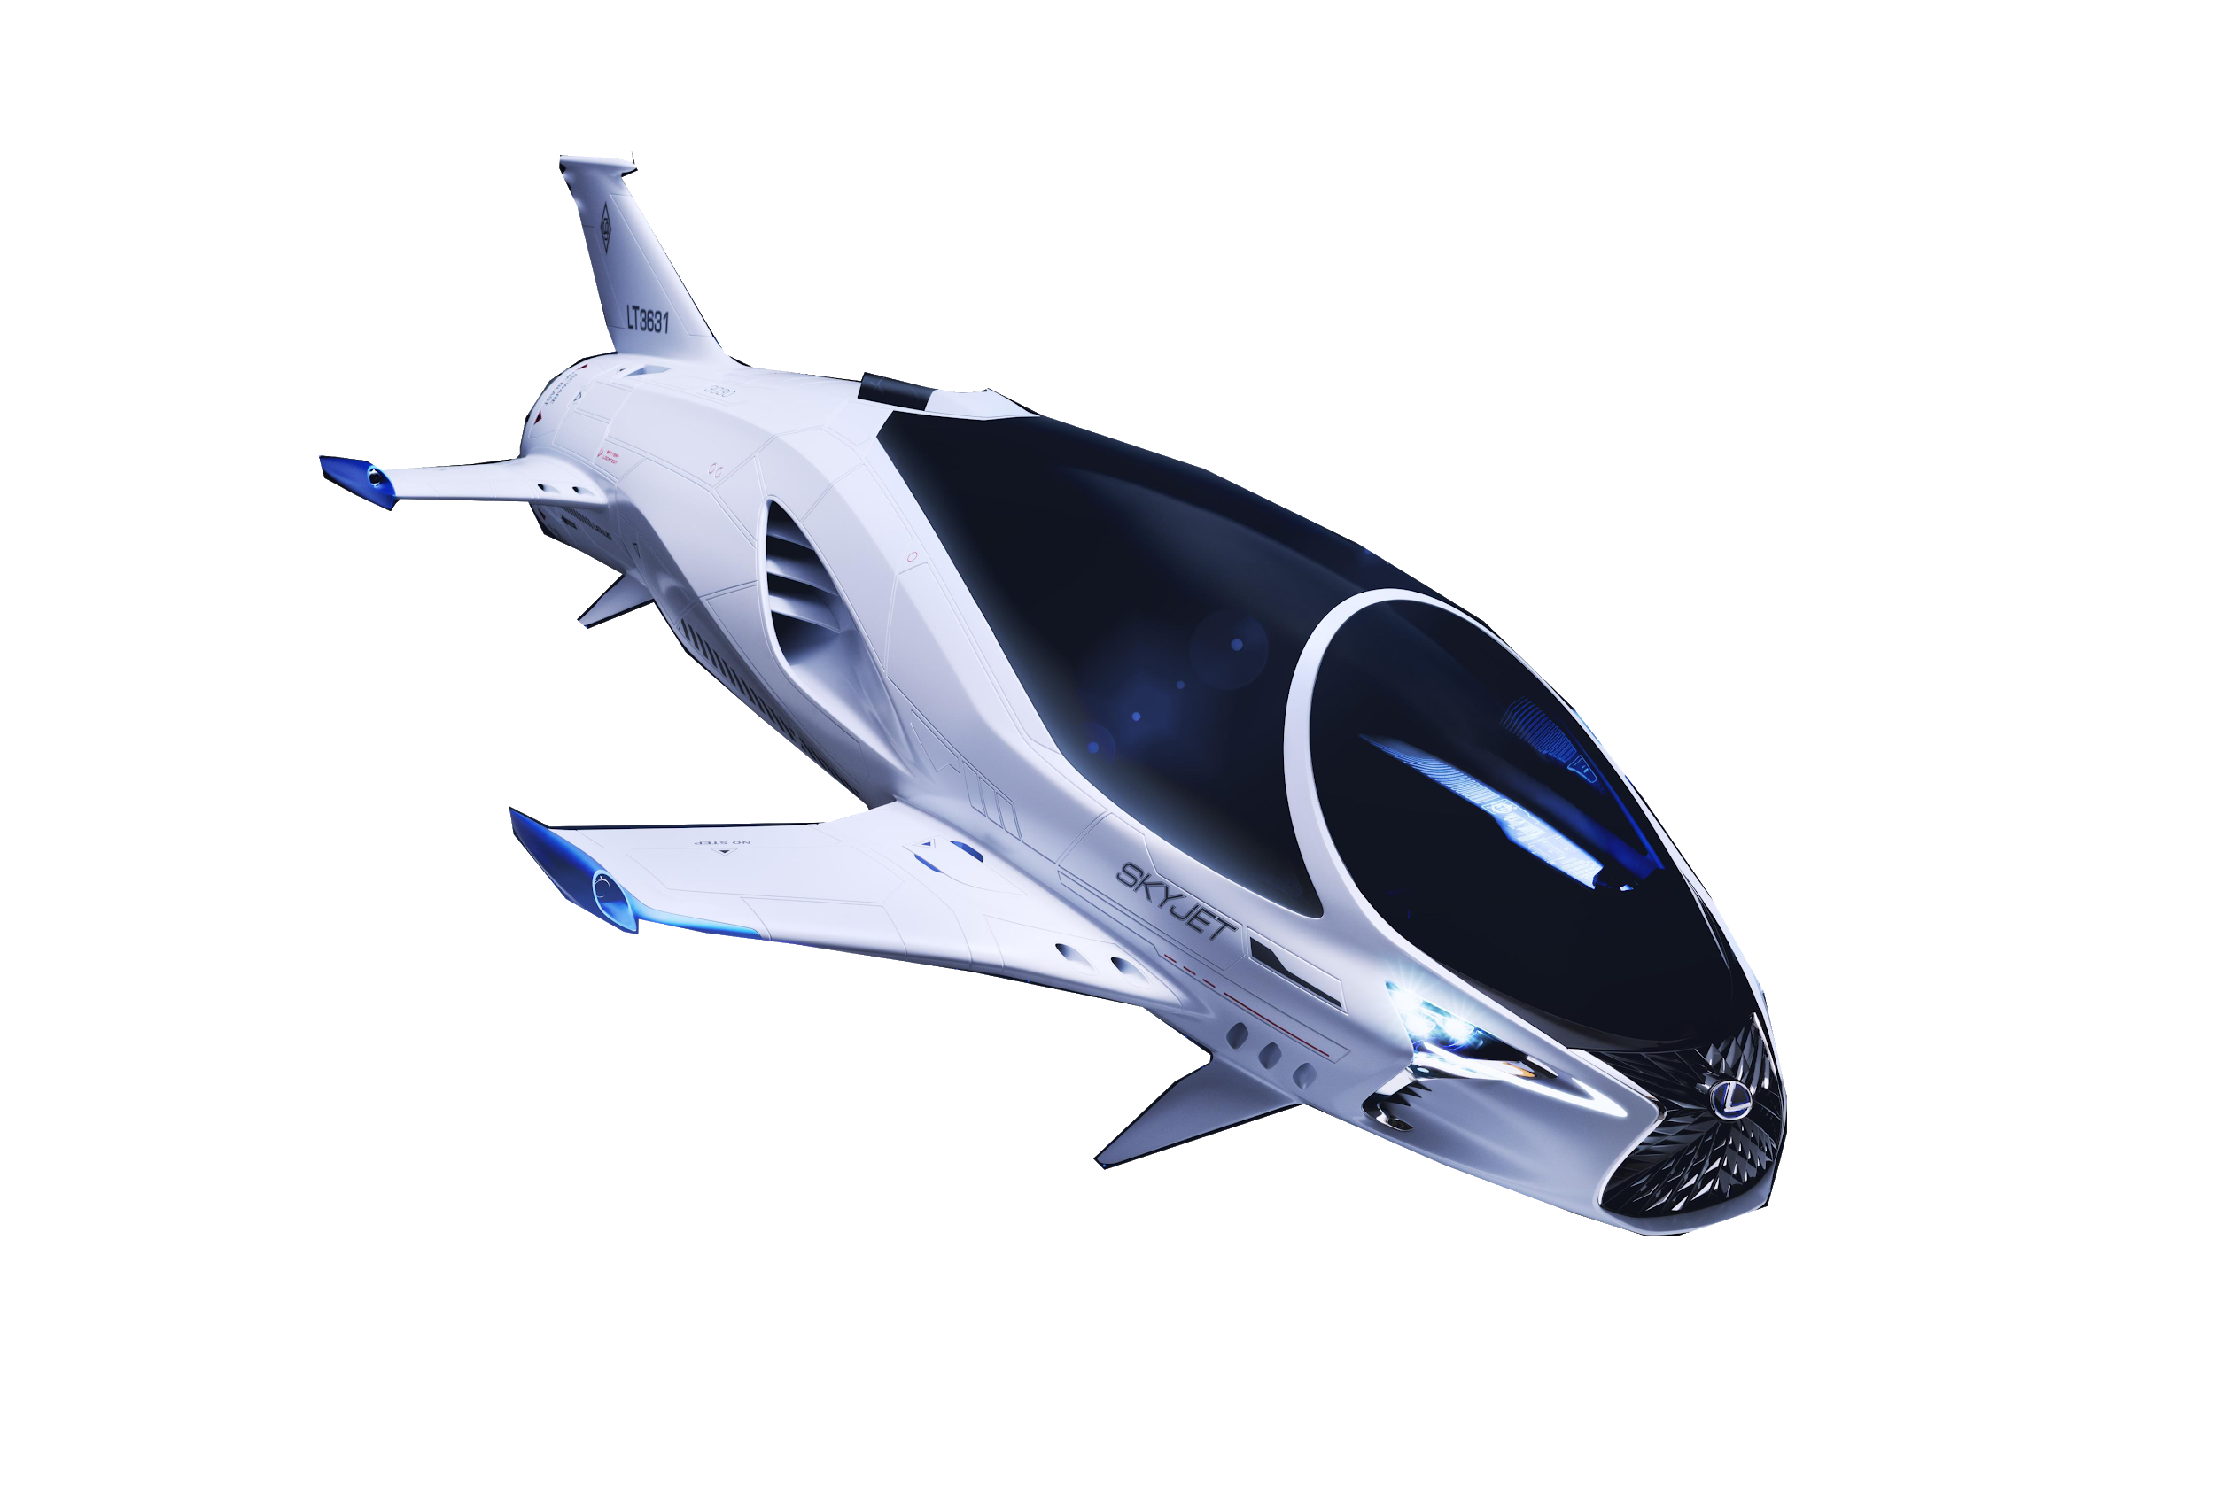
What to do next
Notes:
Nicolas + Kevin
Integration of new assets
READ ME => Demonstration and explanation of science software installation and proce- dure.
Integration of other data sources than avaiable with Gaia
Comparate real data with gaia one ?
New ideas of features ?

